Slide 1
SALES FORCE AUTOMATION

Slide 2
ABSTRACT
Sales force automation application is designed to implement and monitor sales activities of an enterprise. It involves various parties like Administrator, Salespeople, other enterprise users etc. Administrator is able to handle all sales activities of an enterprise comprised of multiple sales users. Every salespeople is provided by a unique credentials and using these credentials they can log their sales activities. These activities further monitored by Administrator of the enterprise. Moreover, this application acts as a CRM for an enterprise to handle the modules such as customers, contacts, events, opportunities, campaigns etc.

Slide 3
TABLE
CUSTOMER TABLE
FIELD NAME | DATATYPE | DESCRIPTION
Id | Int | Id of customer
Name | Varchar | Name of customer
Address | Varchar | Address
Gender | Varchar | Gender
Mobile no | Int | Mobile no
Email | Varchar | Email
Birthdate | Int | Birth date
Username | Varchar | Username
Usertype | Varchar | User type
Password | Varchar | Password
Confirmpassword | Varchar | Confirm password

Slide 4
EMPLOYEE TABLE
FIELD NAME | DATATYPE | DESCRIPTION
Emp_id | Int | Id for Employee
Name | Varchar | Employee name
Phone | Int | Phone number
Address | Varchar | Address
Email | Varchar | Email
Username | Varchar | Username
Password | Varchar | Password
Ifsc | Int | Ifsc code
Bank | Varchar | Bank
Accno | Int | Account number

Slide 5
CONTACT TABLE
FIELD NAME | DATATYPE | DESCRIPTION
Name | Varchar | Name of the customer
Department | Varchar | Department
Email | Varchar | Email
Account name | Varchar | Account name
Street | Varchar | Street name
City | Varchar | City name
State | Varchar | State name
Postal code | Int | Postal code
Country | Varchar | Country
Description | Varchar | Description

Slide 6
EMAIL TABLE
LOG TABLE
FIELD NAME | DATATYPE | DESCRIPTION
From | Varchar | From email
To | Varchar | To email
Subject | Varchar | Subject
Body | Varchar | Body
FIELDNAME | DATATYPE | DESCRIPTION
Title | Varchar | Title
Body | Varchar | Body

Slide 7
FEEDBACK TABLE
SHOPINGITEMS
FIELD NAME | DATATYPE | DESCRIPTION
Fid | Integer | Id of Each Feedback
From | Varchar | Name of customer
Content | Varchar | feedback
FIELD NAME | DATATYPE | DESCRIPTION
Name | varchar | Shopping item name
Price | Integer | Item price
Description | varchar | Description

Slide 8
CART
FIELD NAME | DATATYPE | DESCRIPTION
Username | varchar | Username
Item_id | Integer | Id of item
Name | varchar | Name
Price | Integer | Item price
Booked | varchar | Booked

Slide 9
PAYMENT
FIELD NAME | DATATYPE | DESCRIPTION
First_name | varchar | First name
Last_ame | varchar | Last name
Phone | Int | Phone number
Address | varchar | Address
Town | varchar | Town
Account | Int | Account number
Ifsc | Int | Ifsc code
Username | varchar | Username
Itemname | varchar | Item name
Price | Int | Price

Slide 10
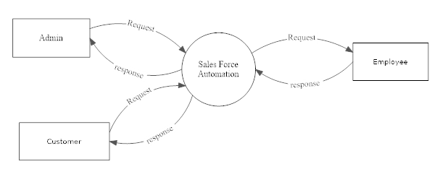
DFD Level 0 DFD

Slide 11
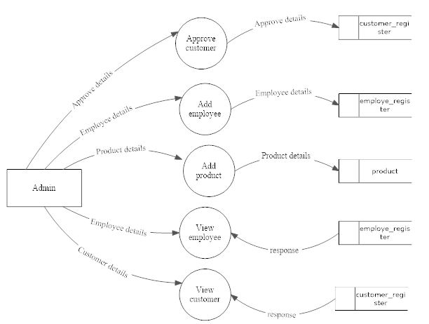
Level 1 DFD for Admin

Slide 12
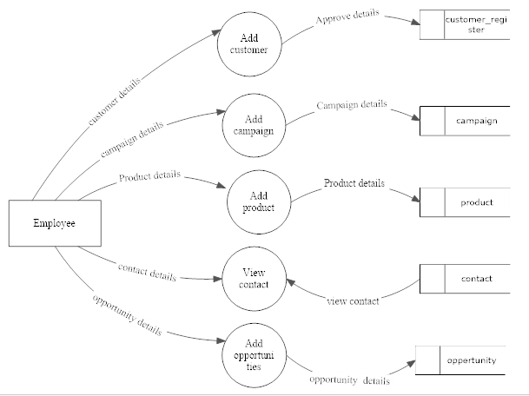
Level 1 DFD for Employee

Slide 13
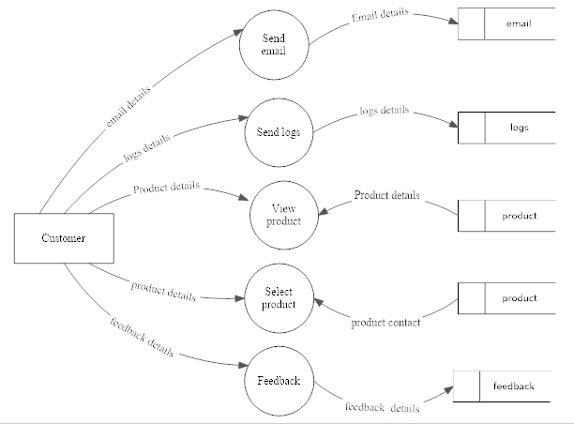
Level 1 DFD for Customer

Slide 14
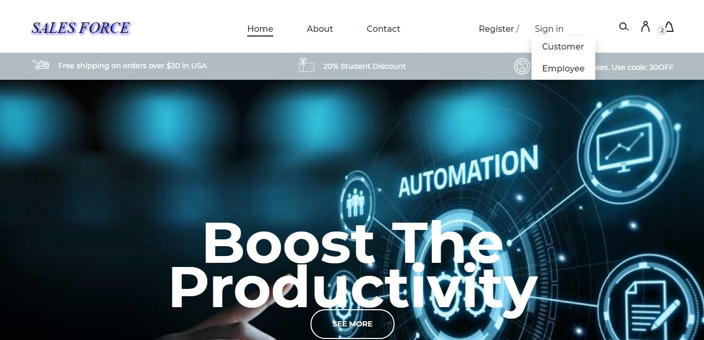
SCREEN SHOTS
Home Page

Slide 15
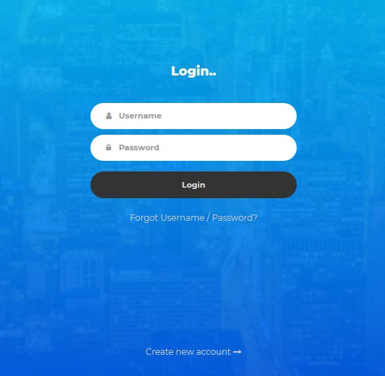
Login Page

Slide 16
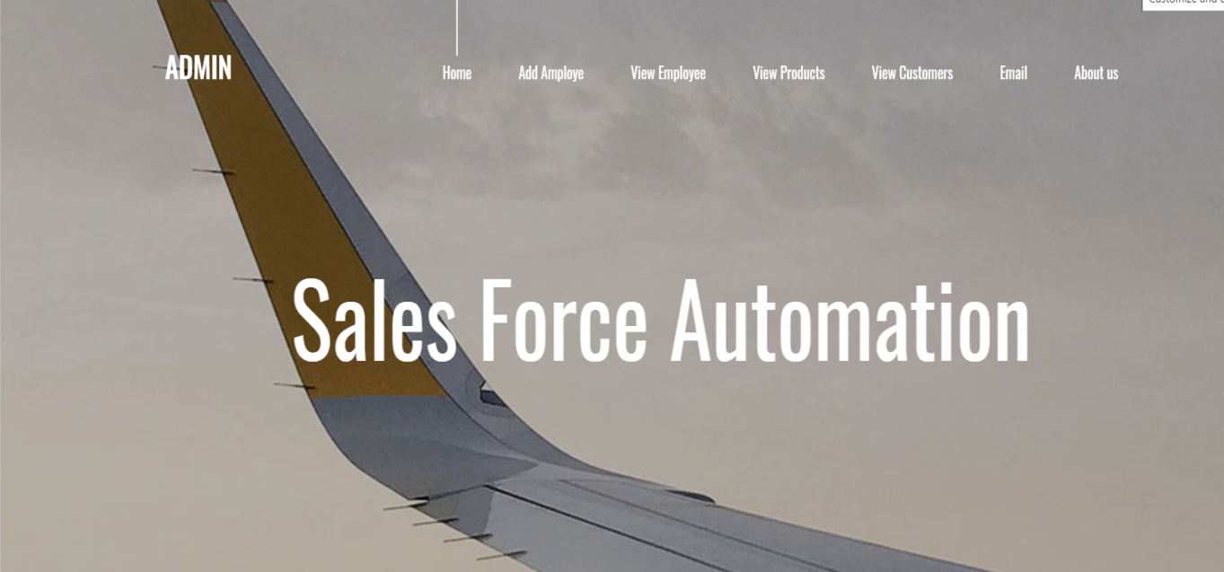
Admin Home Page

Slide 17

Customer Home Page

Slide 18
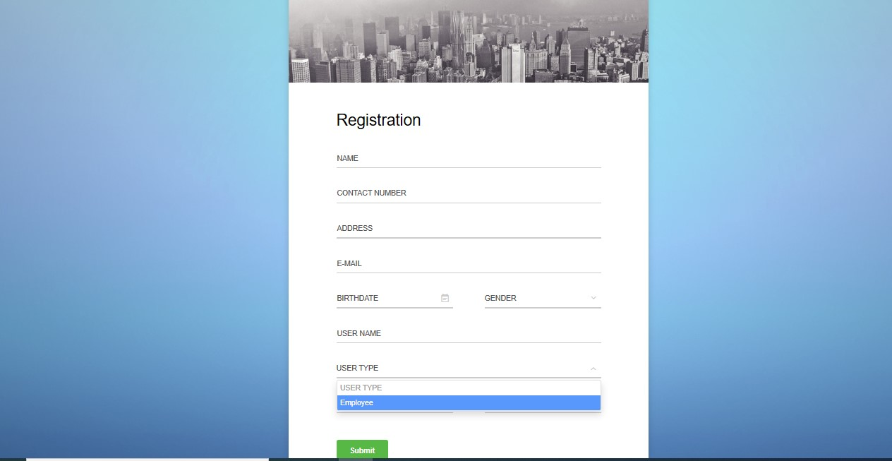
Admin Add Employee

Slide 19
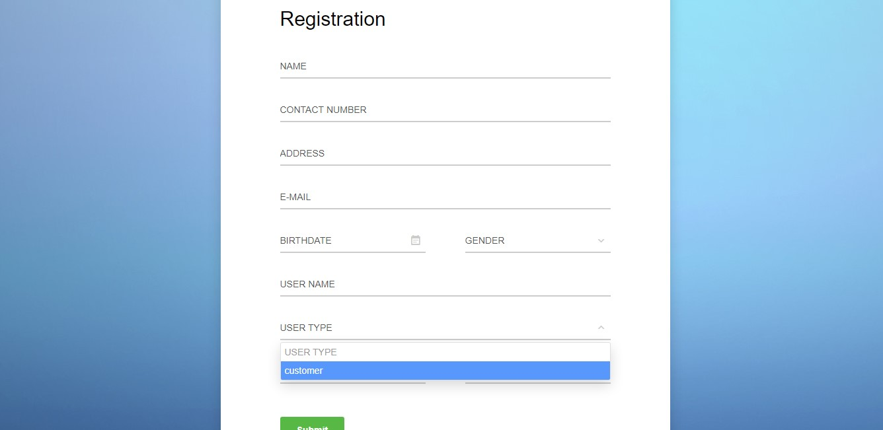
Customer Register

Slide 20
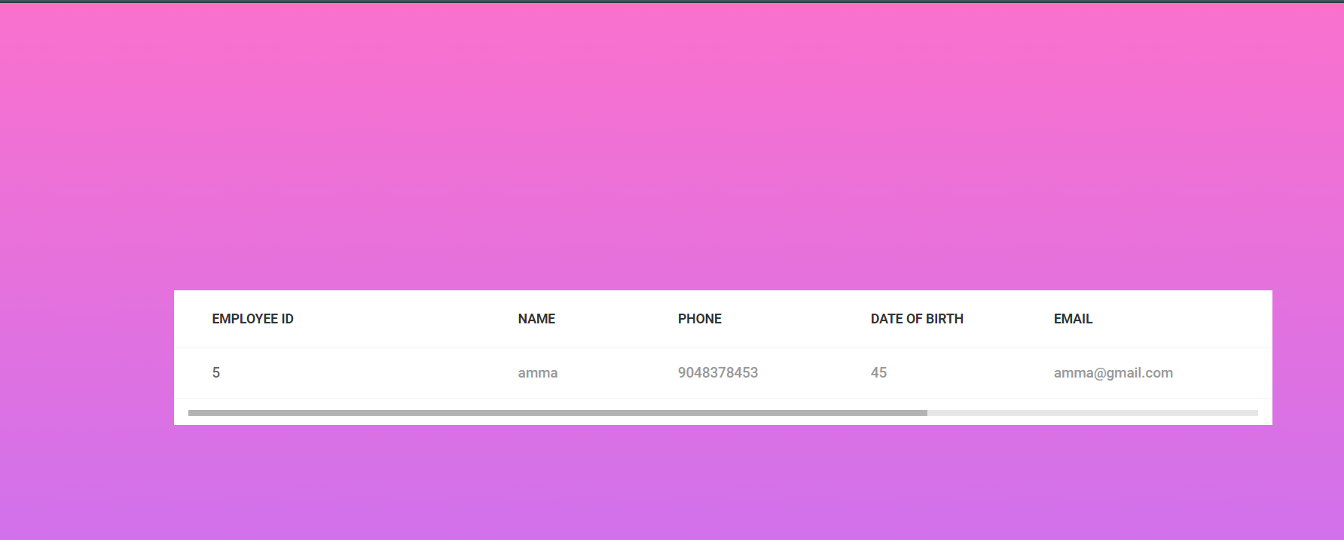
Admin View Employee

Slide 21
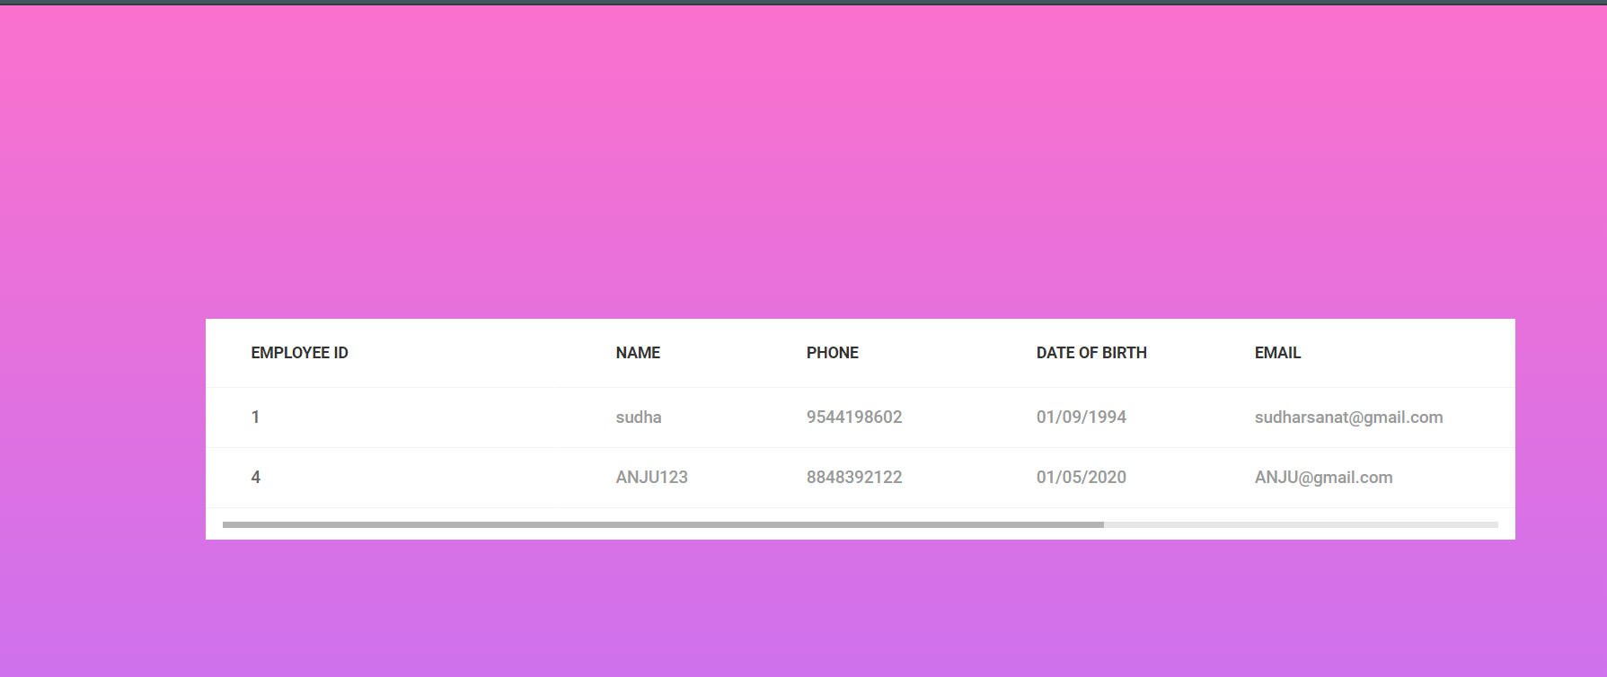
Admin View Customer

Slide 22
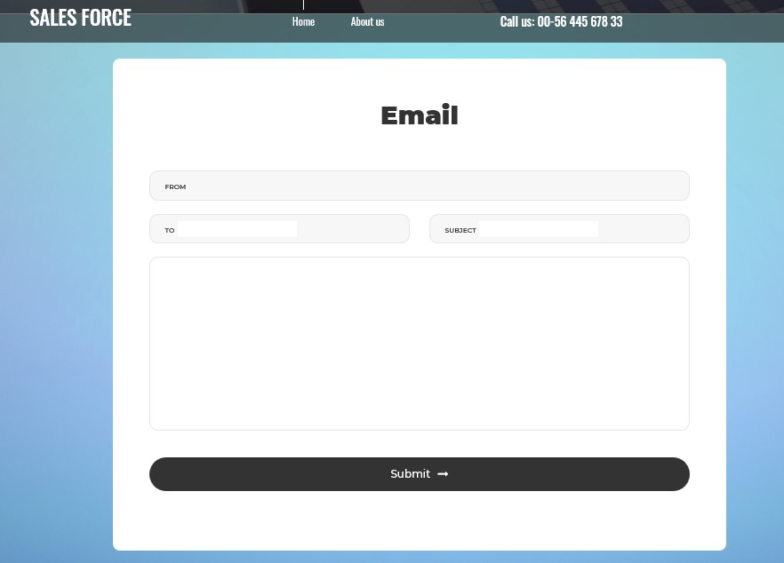
Email Page

Slide 23
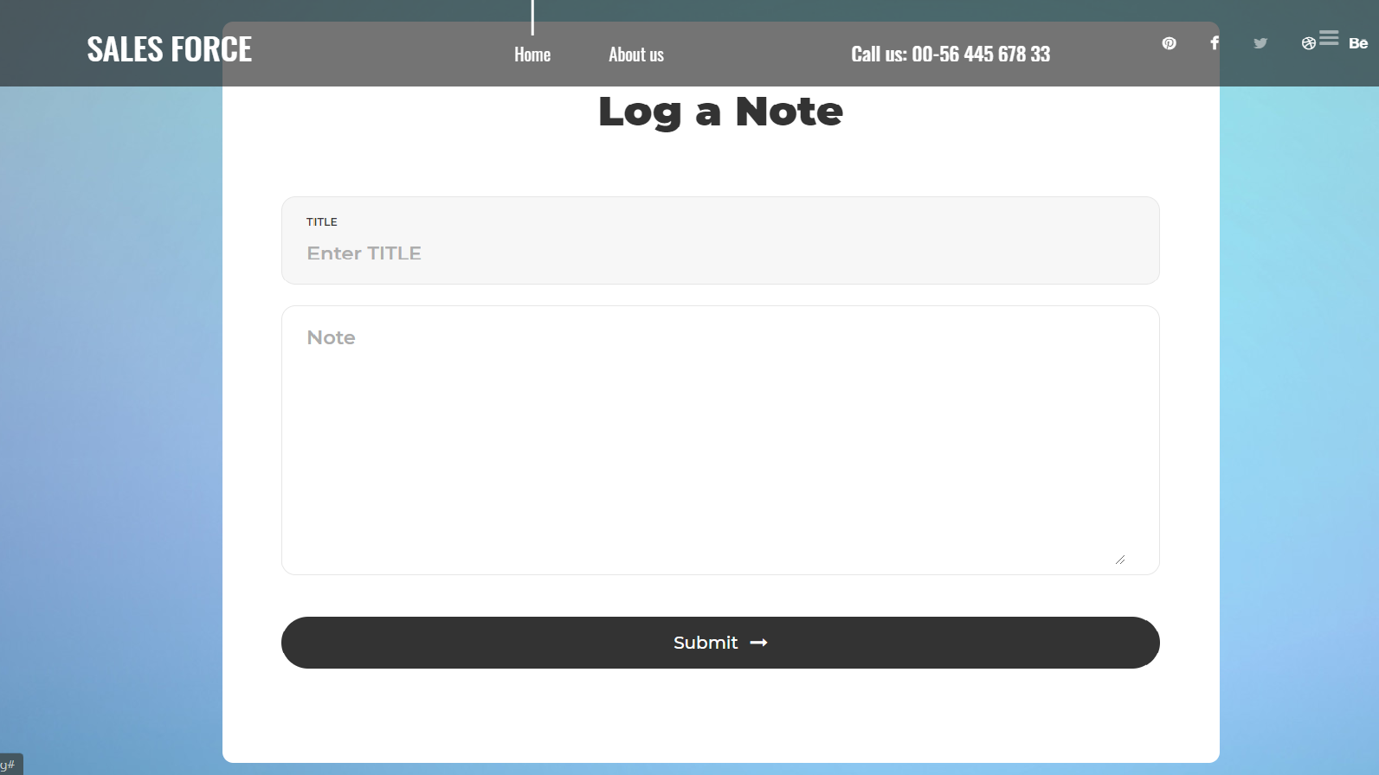
Logs Page

Slide 24
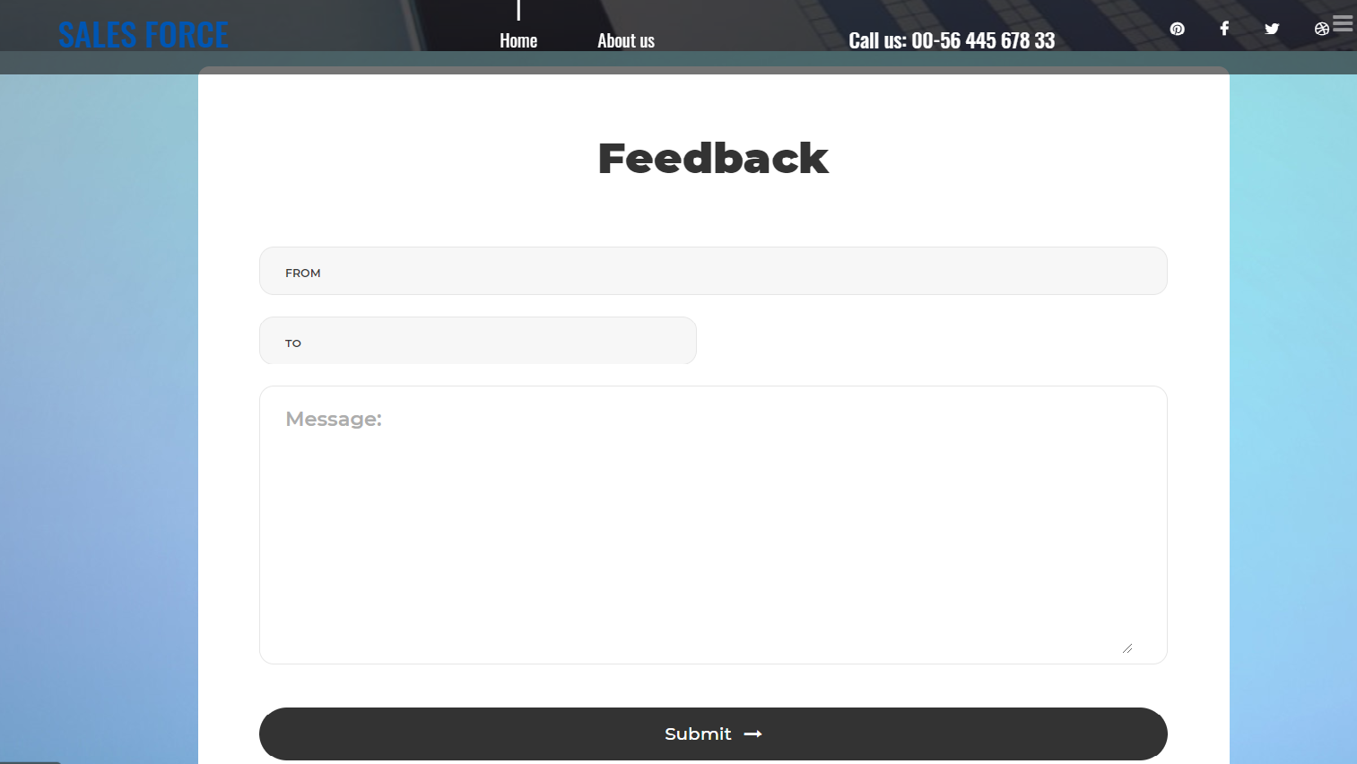
Feedback Page

Slide 25
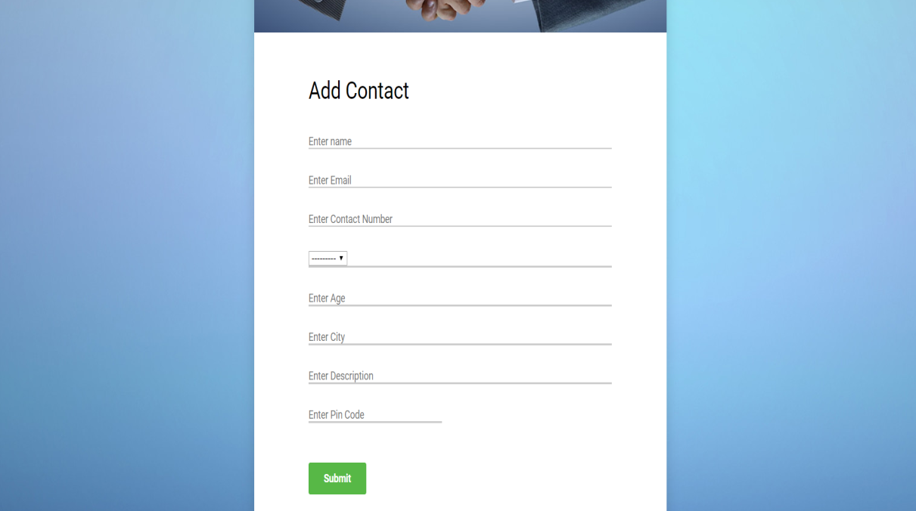
Employee Add Contact

